Slide 1

Project 2: EDA
SATs and Drug Use

Slide 2

Project SAT

Slide 3
Project SAT - Background
Purpose: provide insights into high school education outcomes
In this report, we investigate:
SAT Completion rate by state
Completion rate by state legal requirements to complete SAT
Relationship of Math and Verbal sub-scale SAT scores

Slide 4
SAT Data Set
Each line in data-set represents a US state
Dropping of of ‘All’ for analysis
51 lines (50 states +DC)
Data Dictionary
State: Contains the 50 states of the US plus DC
Rate: State completion rate (%) of Scholastic Aptitude Test (SAT)
Verbal: Median of the Verbal component (of SAT)
Math: Median of the Math component

Slide 5
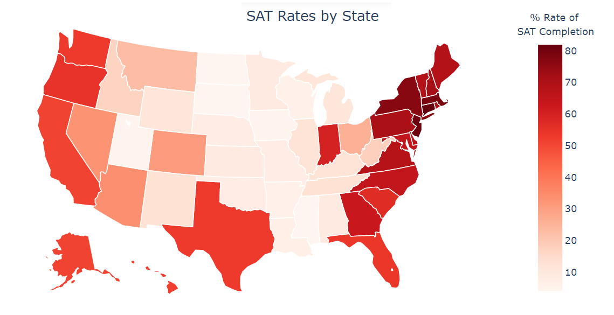
The SAT completion rate varies considerably by state with the highest rates observed on the east and west coast states compared to central states

Slide 6
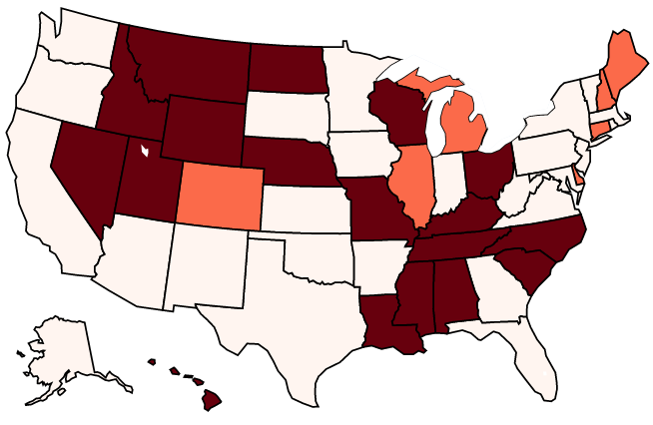
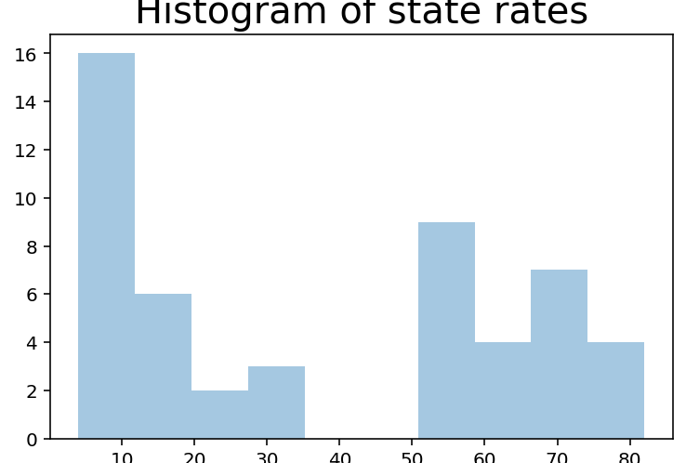
State legal SAT completion requirements a possible contributor to state differences with SAT or American College Testing (ACT) differing between states, although unlikely to be only factor
Distribution of SAT suggests two sub-groups in completion rates by state
SAT Required
ACT Required

Slide 7
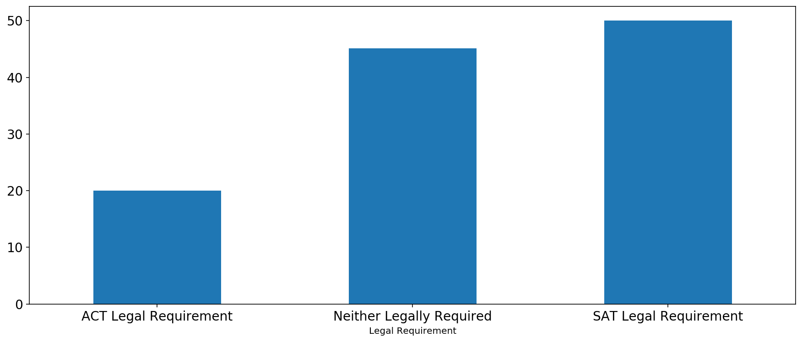
In support, states legally requiring completion of SAT legal show higher completion rates compared to those requiring ACT completion
50.0%
45.1%
20.0%

Slide 8
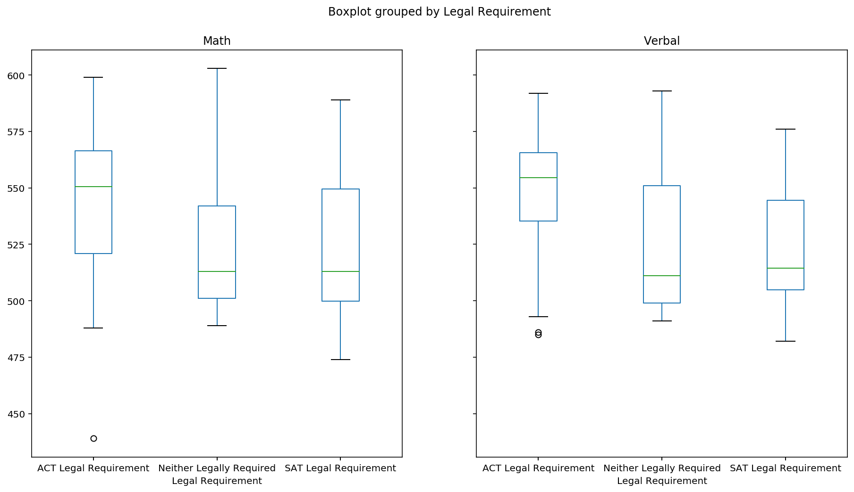
Surprisingly, ACT legal requirement states have higher SAT Math and Verbal SAT scores
Possible explanations
ACT states are more aligned to SAT requirements possibly due to teaching practices
Possibility of more specialist schools (e.g. private) in ACT legal states, which also tend to have lower SAT completion rates
DFAC
DFAC

Slide 9
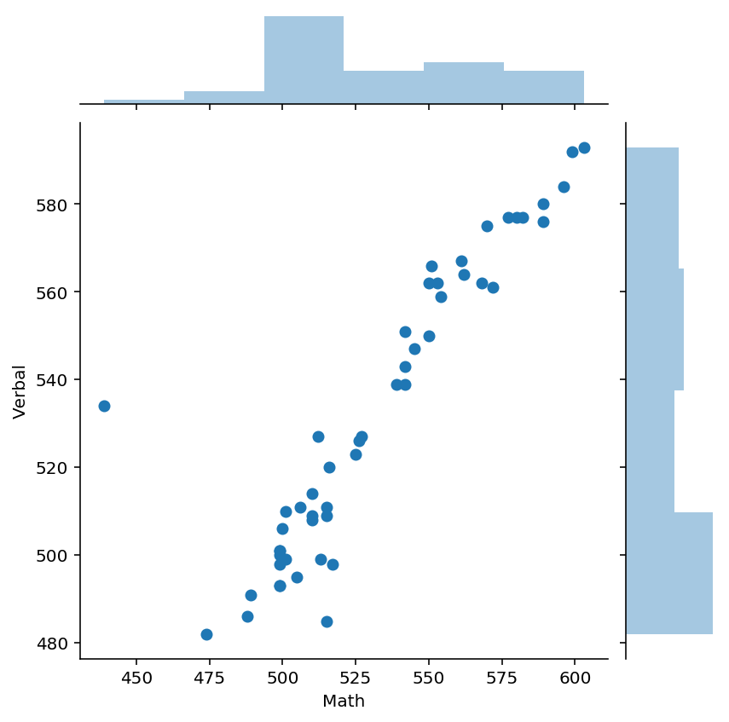
States with higher Maths SAT scores also tend to have higher rates of Verbal SAT scores
Ohio does not quite follow the wider trend in the relationship potentially due to equity concerns in this state (see Kelly, 2018)
Scatterplot demonstrates a strong* positive linear relationship between Verbal and Math (r = .90)
*Classification of strength based on Cohen (1988); Kelly (2018) https://www.daytondailynews.com/news/historically-low-act-scores-red-flag-for-our-country/djfx9Urp719WyEaMfykyxL/

Slide 10
Summary
SAT completion rate varies considerably by state with the highest at 82% (CT) to the lowest at 4% (SD, ND, MS)
State legal requirement for completion of SATs potentially contributes to difference in SAT rates but unlikely to be only contributing factor
States with legal requirements for ACT have higher median verbal and math SAT scores
States with higher Maths SAT scores also tend to have higher rates of Verbal SAT scores

Slide 11
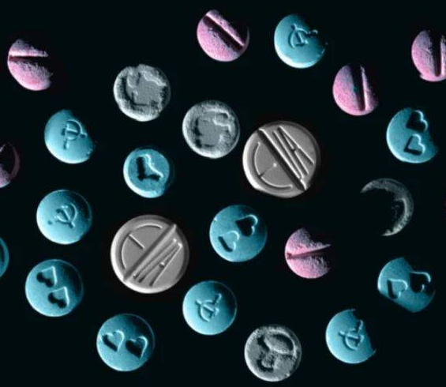
Project Drug Use

Slide 12
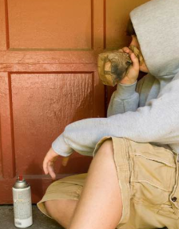
Project Drug Use - Background
Purpose of this sub-report is report on research findings
In this report, we investigate whether teenagers more likely to use inhalants compared to other age groups

Slide 13
Background & Hypothesis (H₁)
Inhalants are breathable chemical vapors that can be inhaled to induce a psychoactive or mind-altering effect (National Institute on Drug Abuse, 2012)
Easy accessibility and relatively low cost may contribute to use by teenagers (Ditmar, 2011)
Increased financial resources and exposure to other forms of drugs in young adulthood may mean inhalant use reduces as teenagers move into adulthood
H₁: Teenagers will have significantly higher rates of inhalant use in the previous 12 months than all other age groups.

Slide 14



Key Definitions and Data Set
Teenagers: teenagers are defined at those aged 12-17 (inclusive)
Older others: older others are defined at those aged 18+ (inclusive)
Inhalant use: defined as the use of inhalants in preceding 12 month period

Slide 15


Data Set and Analysis Notes
Data Set
Analysis Notes
-Multiple drug category percentage use by 16 age groups ranging from 12 to 65+
-US based
-Total sample size n = 55,268
Teenagers n = 17,399
Older other n = 37,869-
-Directional hypothesis so 1-tailed test used
-Alpha level (α) = .05
-Assumes random sampling

Slide 16

In the preceding 12 months, overall inhalant usage in the population was low. However, teenagers showed significantly higher rates of use compared to older others
Difference is statistically significant (p < .001)*
*Based on proportion test

Slide 17
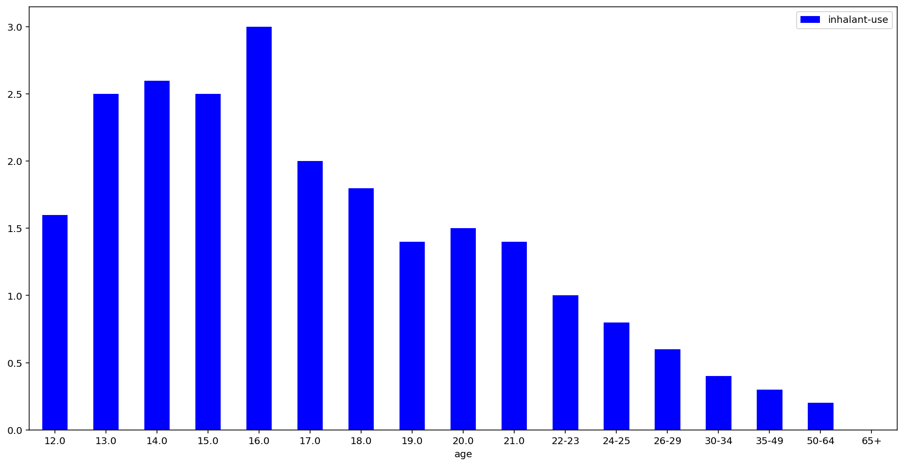
Peak inhalant use occur at 16 years of age and declines from this age onwards providing increased support for financial resource and ease of access to alternative drug types
Peak Inhalant Use at 16

Slide 18
Conclusions
Teenagers (12-17 years of age) were significantly more likely to have used inhalants (2.37%) compared to those aged 18+ (0.75%)
Easy accessibility and relatively low cost of inhalants likely to contribute
While the overall use remains low, there is approximately 23.7 million aged between 12-17 in the US* suggesting that approximately 561,690 teenagers have used an inhalant in the previous 12 months in the US.
*https://www.childstats.gov/americaschildren/tables/pop1.asp

Slide 19
Thank you Questions?

